Slide 1



AGE 214: Lecture 13
Operational Amplifiers: Ideal Characteristics
Sokoine University of Agriculture
AGE 214 - Lecture 13

Slide 2
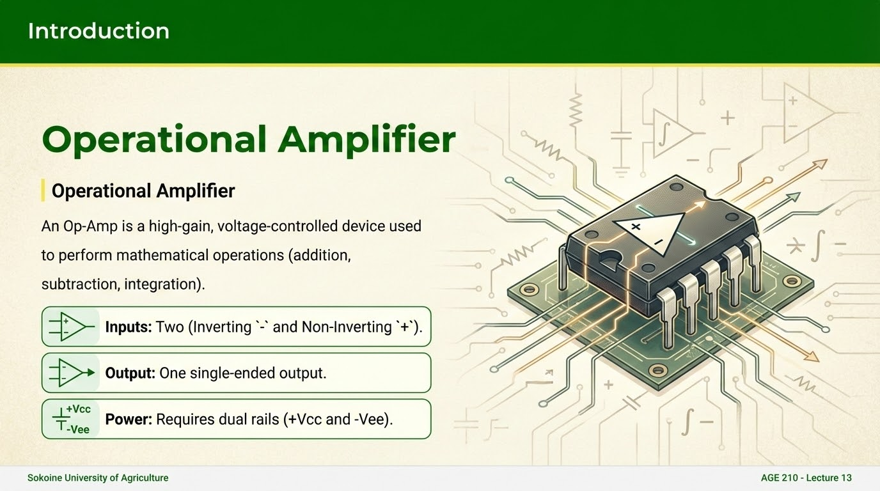

Slide 3







The Ideal Op-Amp
Infinite Open Loop Gain
Infinite Input Impedance
Zero Output Impedance
A_{OL} = ♾️. It amplifies the smallest difference immensely.
Z_{out} = 0. It can drive any load without voltage drop.
Z_{in} = ♾️. It draws ZERO current from the source.
Sokoine University of Agriculture
AGE 214 - Lecture 13

Slide 4
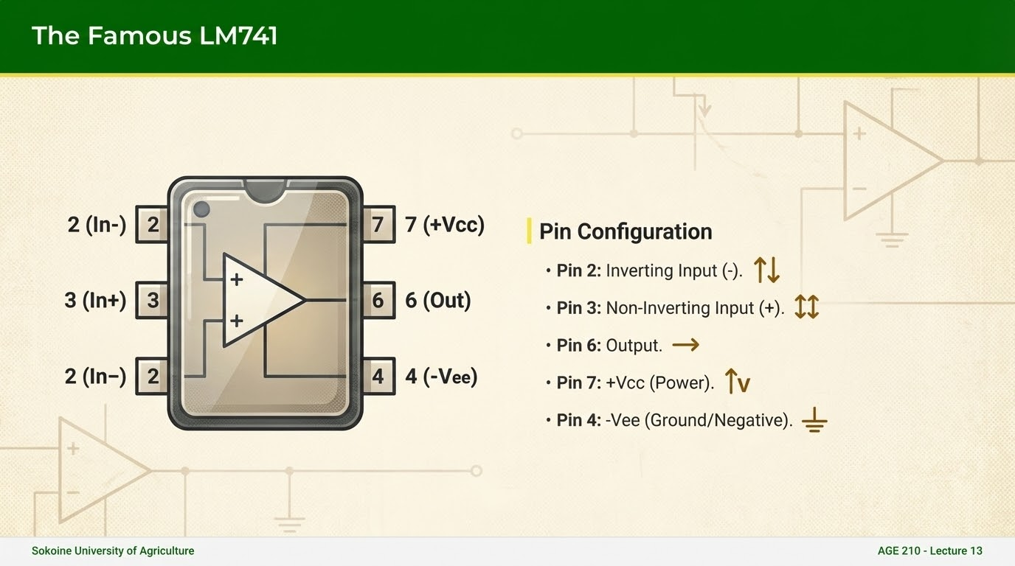

Slide 5
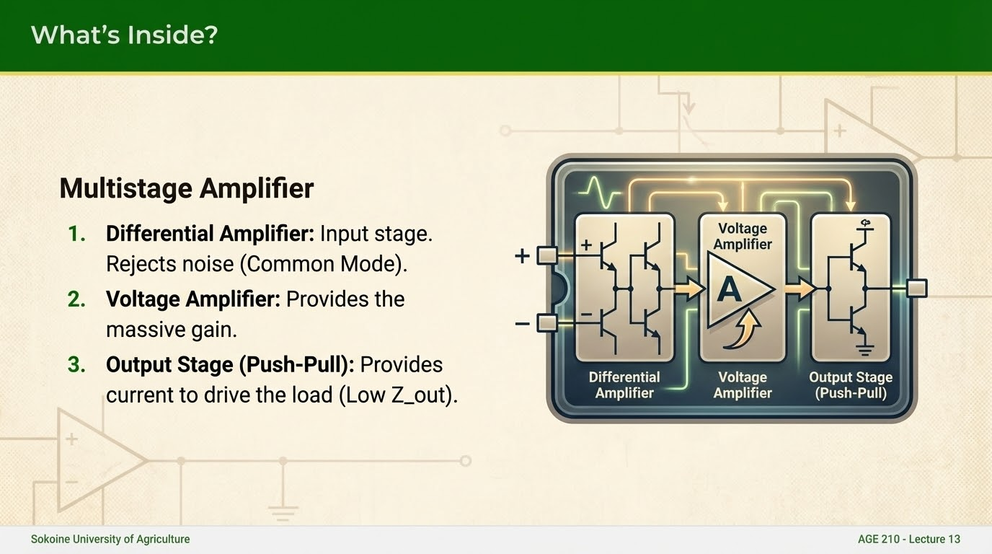

Slide 6
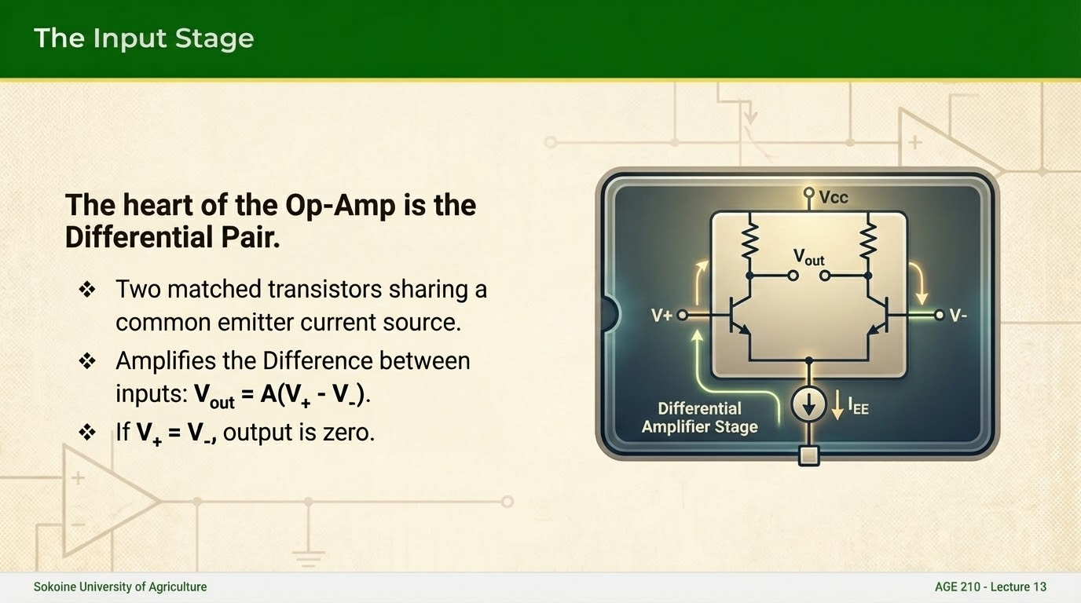

Slide 7

Common Mode Rejection Ratio
Noise Rejection
Noise usually affects both inputs equally (Common Mode Signal).
CMRR measures the Op-Amp's ability to reject these common signals and amplify only the difference.
Ideal CMRR = $\infty$. Typical 741 CMRR = 90 dB.
Sokoine University of Agriculture
AGE 214 - Lecture 13

Slide 8
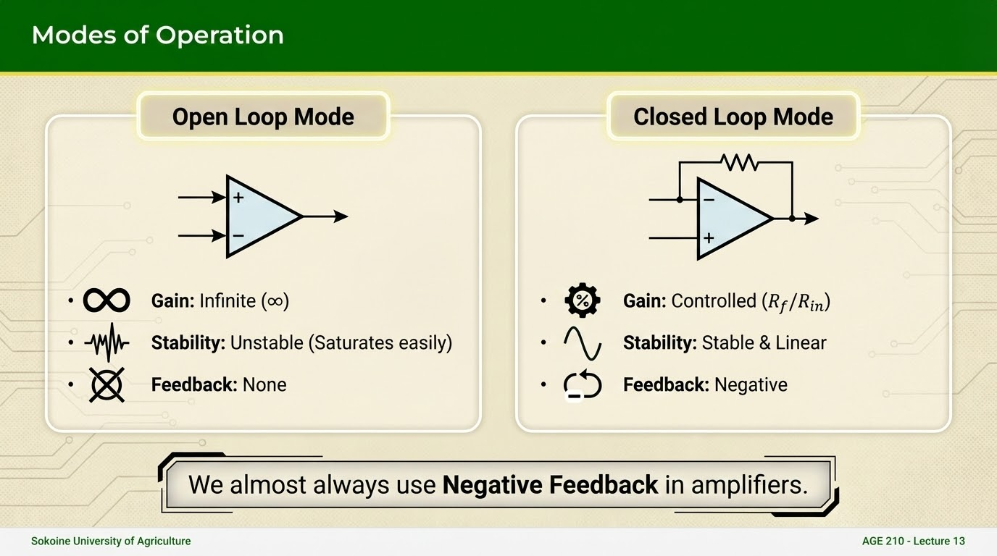

Slide 9
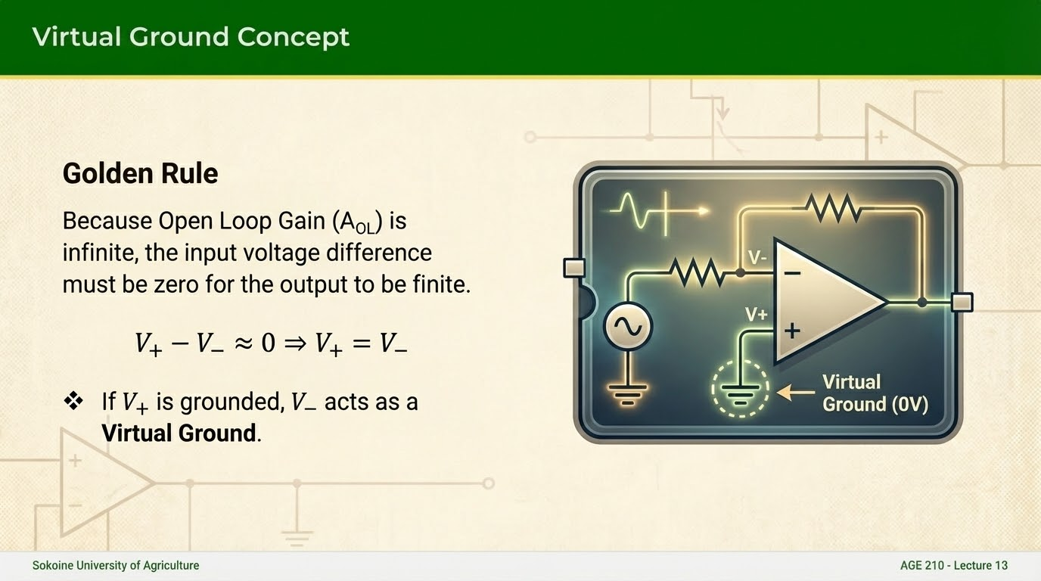

Slide 10
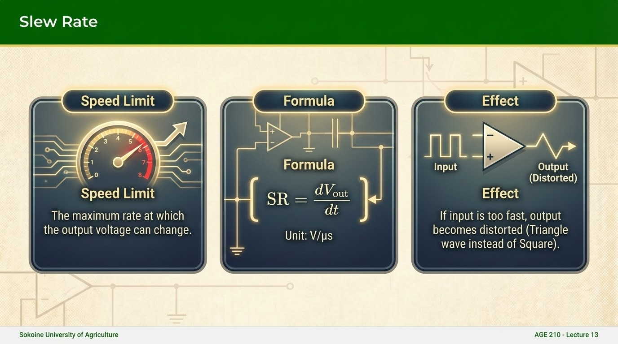

Slide 11
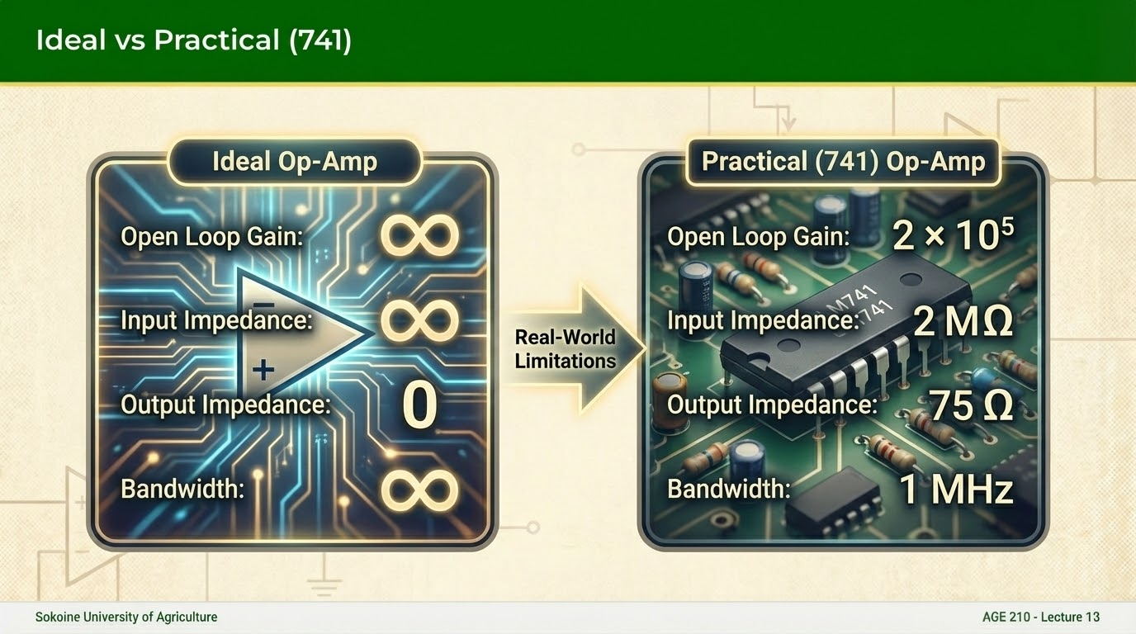

Slide 12
Questions?
Next Lecture: Basic Op-Amp Circuits
Dr. Kadeghe Fue
Sokoine University of Agriculture
AGE 214 - Lecture 13

